Slide 1
Food Giant Flyer Creator
Kendrick Hagerman
Computer Science Project - COT6931
Notes:
Hello, I’m Kendrick Hagerman and this is my Powerpoint Presentation for my Capstone, the Food Giant Flyer Creator
This is for COT 6931
f you were presenting in front of an audience or for a client acceptance, you would be describing the background of your project, objectives, the purpose of your project, why your project is important, what you accomplished, all the while describing your design and demonstration of the product or discussion for first semester students.

Slide 2
Overview
Background/Purpose
Discussion of initial Client Requirements
Software Requirements of Application
How Requirements changed during development
How Application will be deployed
Azure Overview and Justification
Virtual Machines and ASP.Net
Design and Reasons for Design
Software Design Document
Prototype Source Code
Brief Prototype Demonstration
Plan for Implementation
Alternate Design Solutions
Notes:
For this presentation, I will define the Project’s Objective
Show an example flyer I was given for my client, which was used for my program’s requirements
Discuss my Initial Steps including the Project’s Definition and Initial Software Components
Purpose

Slide 3
Background
Project is for the Food Giant
Problem came up when talking about work with friend
Stores have issue with excess inventory
No way to quickly promote store-specific sale items
Notes:
This project is for the Food Giant grocery store chain
“Food Giant actually consists of multiple grocery stores, Food Giant, Piggly Wiggly, Pic N Save, Mad Butcher, Save Mart, and Citronelle Markets
They also cover 8 states” – Reference http://www.foodgiant.com/locations
During a talk with a friend of mine, who is a district manager at Food Giant, he mentioned his company had tried to work with a third-party tech firm to get an application developed, but it fell through
I ended up talking to him about what the application needed to do, and decided on completing it for my Capstone Project
This project’s objective is to both earn more revenue for the store and reduce the cost of eliminating excess inventory before it loses the company income by becoming expired goods.
This will be accomplished by creating a Graphical User Interface (GUI) program designed for District and Store Managers.
The program, named the Food Giant Flyer Creation program, will allow these Managers to generate customized flyers for their store that they can print and distribute to customers.
Currently, they have no way to create flyers in this fashion. The only way customers can find out about store-specific sales is to be at the store.
These custom flyers will allow a store to more easily reach and inform their customer base about sales, which should draw in more customers, potentially increasing revenue.
This program is designed for Managers with very little experience with computers.
The application would help deal with excess store inventory
Currently there

Slide 4
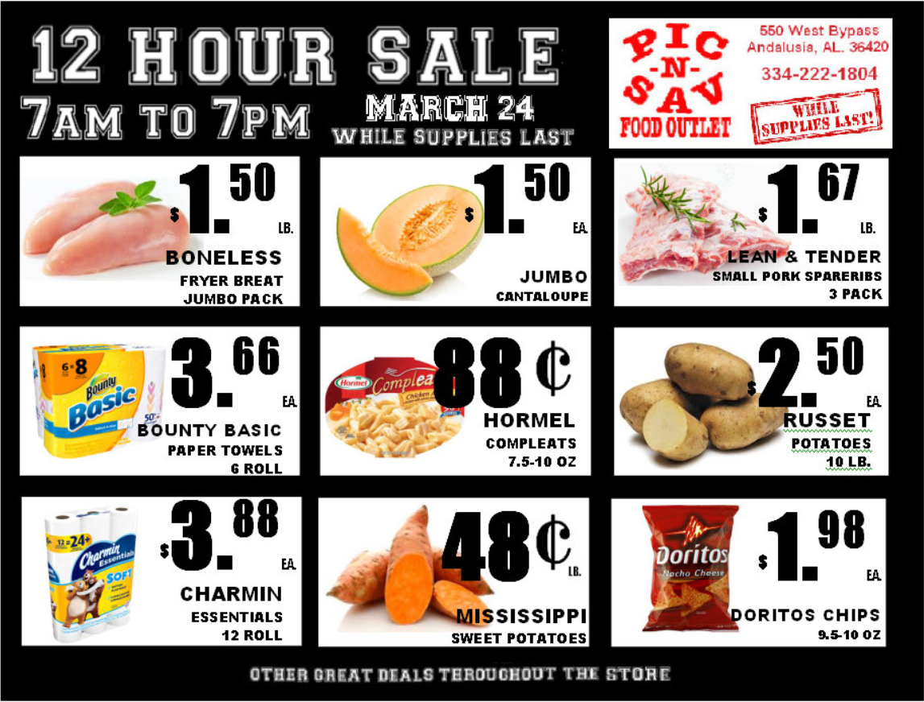
Food Giant Flyer Example
Notes:
Food Giant is a much smaller company than a grocery store chain like Publix, and lack a good consistent flyer design
This is one of the official Food Giant Flyers.
This is designed by a single person in the corporate office
As you can see, it’s pretty basic compared to something like Publix
It looks to be manually assembled in paint or word, you can see a Green Underline over the Russet Potatoes
Some of the lettering isn’t lined up
After seeing that these are the standard flyers for the store, I feel like I can at least generate this kind of Flyer Programmatically, even with my limited design skills

Slide 5
Initial Steps
Thought About Requirements
Worked on Project Definition
Looked into Software Components
Notes:
Like everyone else, I worked on the Project Definition to better understand the objective and requirements of the project
I tried to think about how you could create a page like the one above programmatically.
I know it’s easy to create a template file in something like word that can be manually edited, but it needs to be done via a program to eliminate the chance of user error
This is even more important given the User Base.
The client had informed me that the managers using the product may have very little computer experience.
And like most programs, there will be a varied user base.
I cannot trust the user to know exactly what input they need to enter or even to enter it correctly.
This eliminated a simple template file, and what really allowed me to make this into a project that could be complex enough to work on for a Capstone

Slide 6
Beginning of Design
Started Initial Design
Created Git Repository
Created Basic Prototype

Slide 9
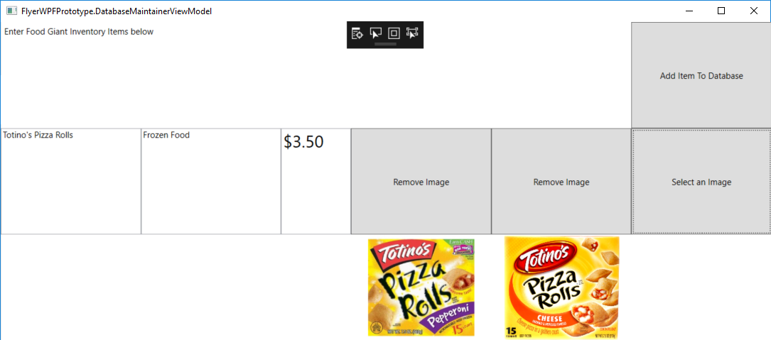



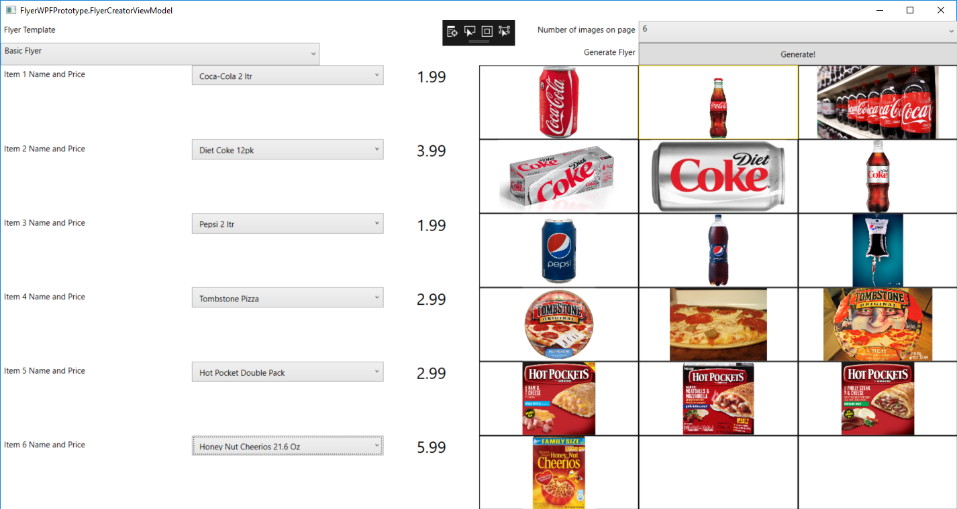
Images Slide

